Slide 1

Selection

Slide 2
Topics
The if statement
The else statement
Cascaded if
Nested if

Slide 3
The if statement
Determines whether a block is executed.
Implements the selection instructions within an algorithm.
Decides what to do by evaluating a Boolean expression.
If the expression is True, the block is executed.

Slide 4
How to write
if condition:
statement(s)
after if statement
age=int(input(‘Your age: ‘))
if age >= 18:
print(‘You are eligible’)
print(‘Done’)

Slide 5
How to write
if condition:
statement(s)
after if statement
Indentation is important!!!
age=int(input(‘Your age: ‘))
if age >= 18:
print(‘You are eligible’)
print(‘But be careful’)
print(‘Done’)

Slide 6
Example: Solution 1
Read in a number, and print it if it is odd.
output “Enter an integer”
input number
if (number is odd)
then
output the number is odd
'''Read in a number, and echo it
if it is odd.
Hint:
even number % 2 is 0
odd number % 2 is 1
'''
number=int(input('Enter a number: '))
if number % 2 != 0:
print(number,'is odd')
Enter a number: 23
23 is odd

Slide 7
Example: Solution 2 (condition changed)
Read in a number, and print it if it is odd.
output “Enter an integer”
input number
if (number is odd)
then
output the number is odd
'''Read in a number, and echo it
if it is odd.
Hint:
even number % 2 is 0
odd number % 2 is 1
'''
number=int(input('Enter a number: '))
if number % 2 == 1:
print(number,'is odd')
Enter a number: 23
23 is odd

Slide 8
Notes on if
Which of the following code fragments are equivalent?
A
if number % 2 != 0:
print("%d", number)
print(” is odd\n")
B
if number % 2 != 0:
print("%d", number)
print(” is odd\n")
C
if number % 2 == 1:
print("%d", number)
print(” is odd\n")

Slide 9

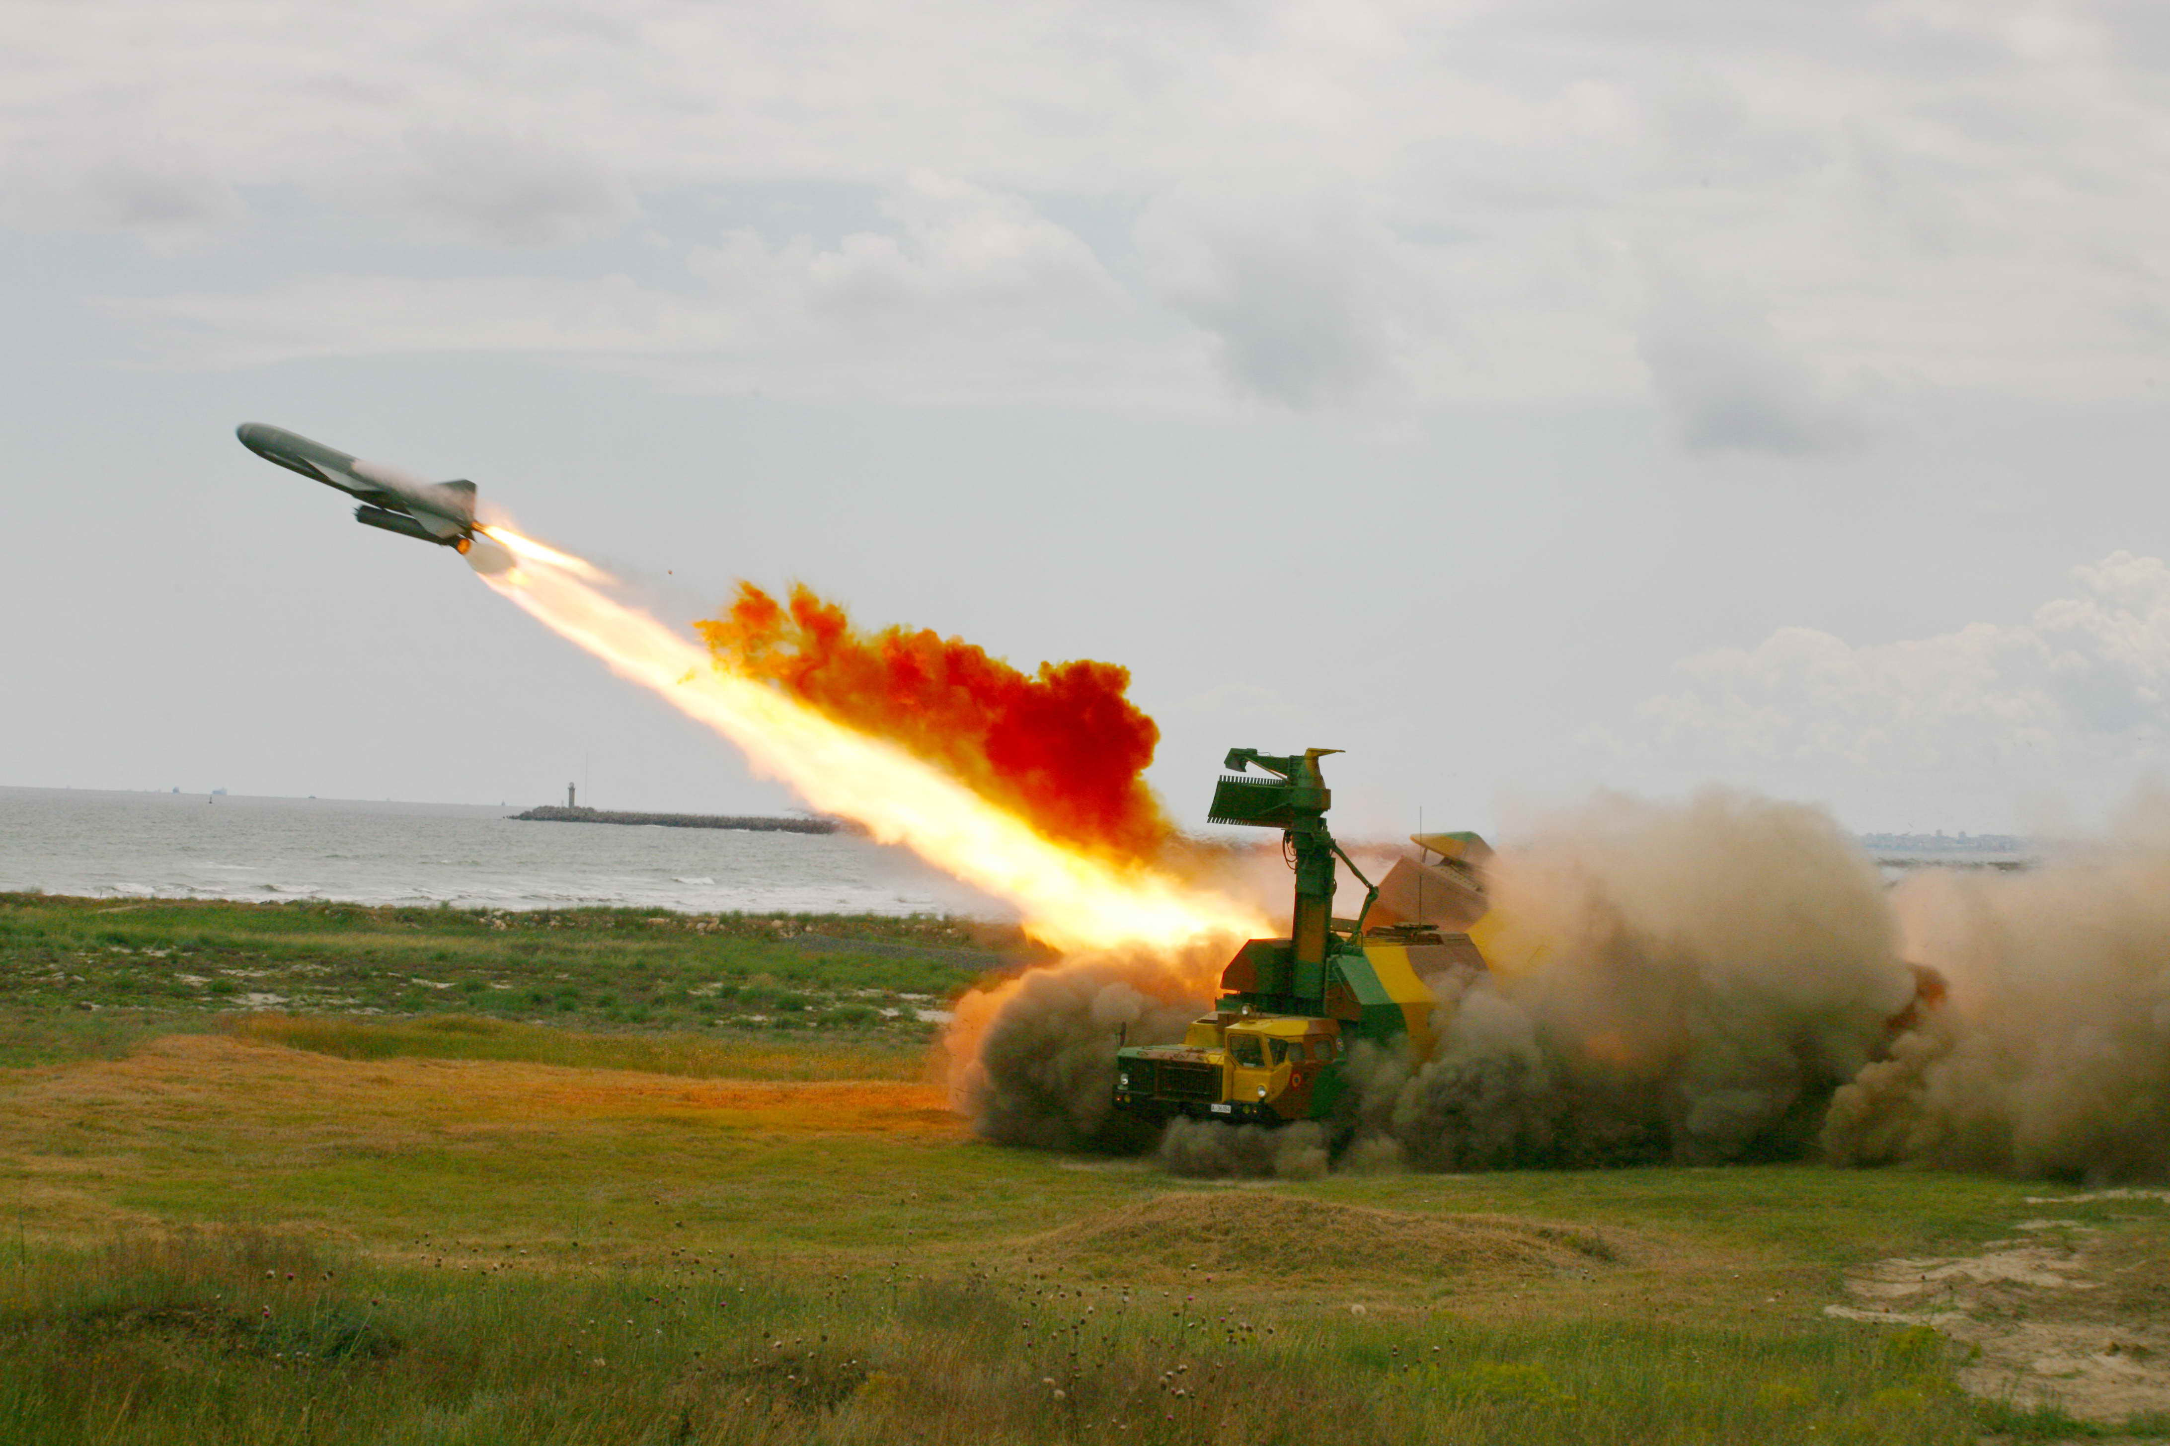

The World’s Last Bug
status = check_radar( )
if (status % 2 == 1)
launch_missiles( ) print(‘R.I.P World bye bye!!!’)

Slide 10
The else statement
Can only occur after an if statement
Is only executed when the if’s block does not execute
if condition:
#condition: True do this
statement(s)
else:
#condition: False do this
statement(s)

Slide 11
Example:
Read in a number, and print it if it is odd or even.
output “Enter an integer”
input number
if (number is odd)
then
output number is odd
else
output number is even
'''Read in a number and determine if it’s odd or even.
'''
number=int(input('Enter a number: '))
if number % 2 != 0:
print(number,'is odd’)
else:
print(number,’is even')
Enter a number: 23
23 is odd
Enter a number: 380
380 is even

Slide 12
Example:
Read in a number, and print it if it is odd or even.
output “Enter an integer”
input number
if (number is odd)
then
output number is odd
else
output number is even
'''Read in a number and determine if it’s odd or even.
'''
number=int(input('Enter a number: '))
if number % 2 == 1:
print(number,'is odd’)
else:
print(number,’is even')
Enter a number: 23
23 is odd
Enter a number: 380
380 is even

Slide 13
Example:
Read in a number, and print it if it is odd or even.
output “Enter an integer”
input number
if (number is odd)
then
output number is odd
else
output number is even
'''Read in a number and determine if it’s odd or even.
'''
number=int(input('Enter a number: '))
if number % 2 != 1:
print(number,’is even’)
else:
print(number,’is odd')
Enter a number: 23
23 is odd
Enter a number: 380
380 is even

Slide 14
Example:
Read in a number, and print it if it is odd or even.
output “Enter an integer”
input number
if (number is odd)
then
output number is odd
else
output number is evev
'''Read in a number and determine if it’s odd or even.
'''
number=int(input('Enter a number: '))
if number % 2 == 0:
print(number,’is even’)
else:
print(number,’is odd')
Enter a number: 23
23 is odd
Enter a number: 380
380 is even

Slide 15
Cascaded if statement
Multiple alternative blocks each with a Boolean expression.
First expression which evaluates to true causes execution of the associated block.
Only at most one block will be executed.

Slide 16
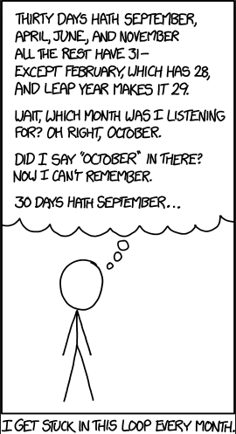
Example: months.c
Thirty Days Hath September | Animated Nursery Rhyme in English
https://www.youtube.com/watch?v=UWEpXETJs5A
Determine the number of days in a given month:
30 days hath September,
April, June and November.
All the rest hath 31,
Excepting February alone,
Which hath 28 days clear,
And 29 in each leap year.
output “Enter an integer”
input month
if (month is September,
or April,
or June,
or November)
then
output “30 days”
else if (month is February)
output “28 or 29 days”
else
output “31 days”
Notes:
"Thirty Days Hath September..." or "Thirty Days Has September..." is a traditional verse mnemonic used to remember the number of days in the months of the Julian and Gregorian calendars. It arose as an oral tradition and exists in many variants. It is currently earliest attested in English, but was and remains common throughout Europe as well.

Slide 17
month=int(input("Enter number of month: "))
thirty_one=[1, 3, 5, 7, 8, 10, 12]
thirty=[4, 6, 9, 11]
if month in thirty:
print("30 days\n")
elif month in thirty_one:
print("31 days\n")
else:
print("28 or 29 days\n")
Output
Enter number of month: 4
30 days
Enter number of month: 2
28 or 29 days
Enter number of month: 8
31 days

Slide 18
Same problem but expected output is month_name:number_of_days
Modify the previous program
month=int(input("Enter number of month: "))
thirty_one=[1, 3, 5, 7, 8, 10, 12]
thirty=[4, 6, 9, 11]
if month in thirty:
print("30 days\n")
elif month in thirty_one:
print("31 days\n")
else:
print("28 or 29 days\n")
Output
Enter number of month: 2
February:28 or 29
Enter number of month: 8
August:31

Slide 19
Same problem but expected output is
month_name number_of_days
month_name:number_of_days
Modify the previous program
month=int(input("Enter number of month: "))
thirty_one=[1, 3, 5, 7, 8, 10, 12]
thirty=[4, 6, 9, 11]
if month in thirty:
print("30 days\n")
elif month in thirty_one:
print("31 days\n")
else:
print("28 or 29 days\n")
Output
Enter number of month: 4
April 30
April:30
Enter number of month: 2
February 28 or 29
February:28 or 29

Slide 20
More Examples
chs=input('enter a character:')
ch=chs[0]
if ch>='a' and ch<='z':
print('lower')
elif ch>='A' and ch<='Z':
print('upper')
elif ch>='0' and ch<='9':
print('digit')
else:
print('other')

Slide 21
More Examples
chs=input('enter a character:')
ch=chs[0]
if 'a' <= ch <= 'z':
print('lower')
elif 'A'<= ch <= 'Z':
print('upper')
elif '0' <= ch <= '9':
print('digit')
else:
print('other')

Slide 22
Example: Nested if
cold_weather=bool(input('Is it cold?'))
if cold_weather :
print('Wear Jumper')
raining=bool(input('Is it raining?'))
if raining :
print('Wear Raincoat')
else :
print('Wear Jacket’)
below_zero=bool(input('Is it below zero?'))
if below_zero :
print('Wear Thermal')
print('Stay safe and healthy')

Slide 23
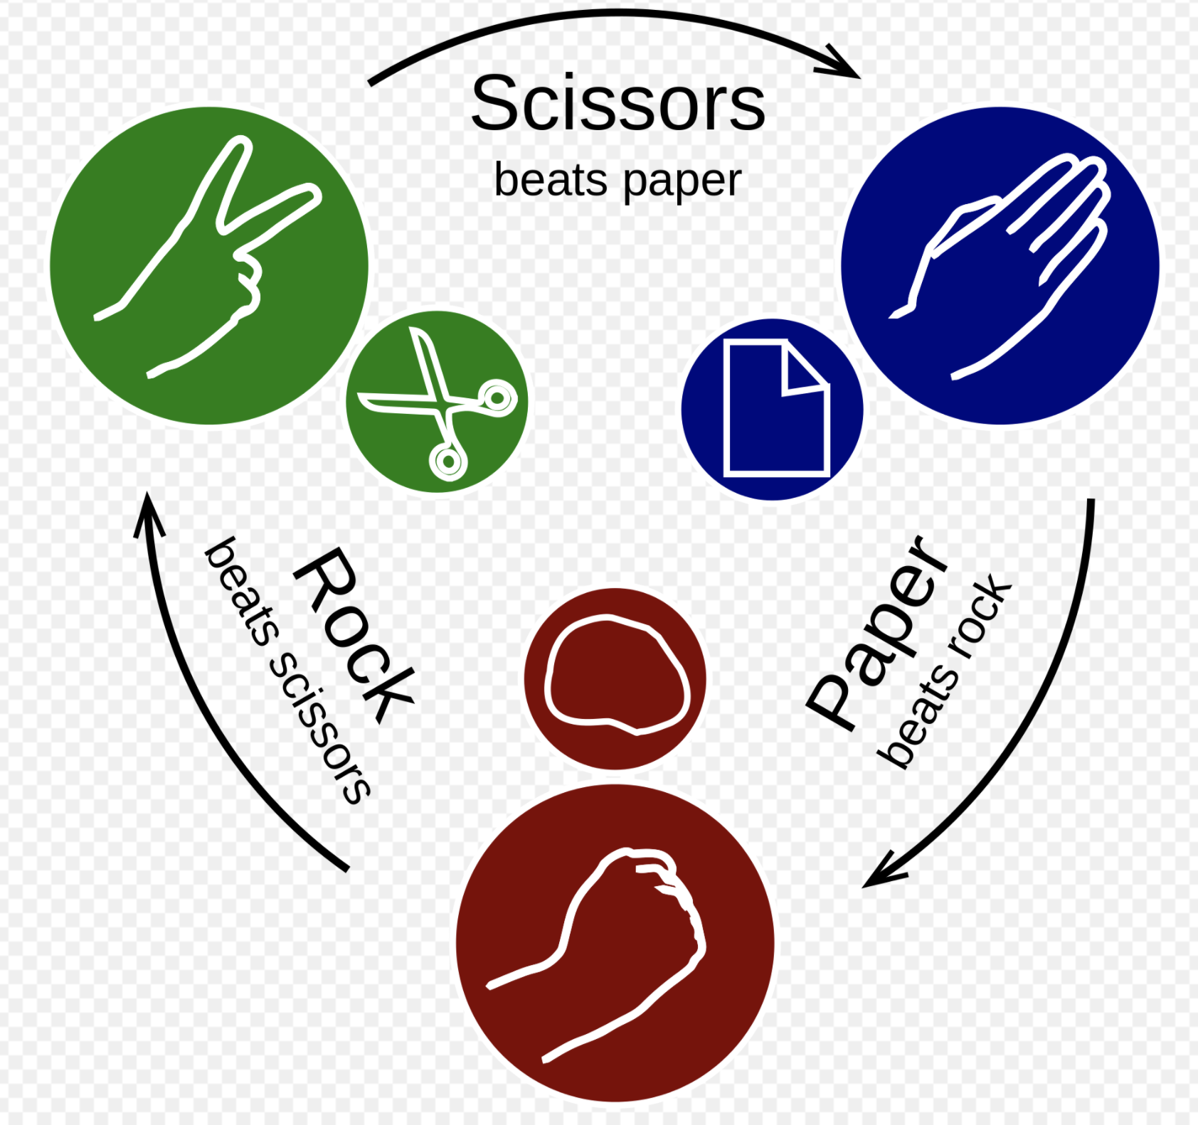



Rock, Paper, Scissors Game
Are you ready to play a game?
What about writing a Python code for your first game?

Slide 24
Rock, Paper, Scissors Game
Hint: You can generate random numbers in Python by using random module. First import
from random import randint
randint(a,b)
#returns a random integer in range [a, b] including end points
num=randint(0,2) # a number between 0 and 2 can be 0 or 1 or 2
die1=randint(0,5)+1 # a number bw. 1 and 6 can be 1,2,3,4,5,6

Slide 25
More Examples
Input a, b and find the max of a,b as c and print c.

Slide 26
More Examples
x=1,2,...10, input x and print 1st, 2nd, 3rd, 4th,...10th depending on the x value

Slide 27
More Examples
x+1, 60 <= x < 100
f(x)= 50, x = 20
x-1, x = 0
0, otherwise
Input x and calculate f(x)

Slide 28
More Examples
Write a program that shows a menu similar to a call center and displays appropriate messages by getting user input.
Samples: https://www.onsip.com/voip-resources/smb-tips/10-sample-call-center-greeting-scripts

